Slide 1
Location analyzer Analyzing the neighborhoods in Mumbai for starting a restaurant
Reported by:
B. MOUNIKA(N160672)
K. KALYANI(N161182)
S. PARVATHI(N160653)
S. JASWANI DEVI(N160666)
SHAMEENA SULTANA(N160562)
G. VIJAY KUMAR(N160413)

Slide 2
Contents
Abstract
Problem statement
Analysis of existing system
Requirements
Data Collection
Methodology
Machine learning algorithm
Result
Discussion
Conclusion
Future work
References

Slide 3
Abstract
We propose a location analyser which analyse the neighbourhoods of the location and recommend the best location for the stakeholders, entrepreneurs etc. The proposed system overcomes the disadvantage of traditional searching system all over the city. The main aim of developing this project is to minimize the searching time of the stakeholders for searching the best location. For the better accuracy we take the data from well organized and secured websites like Foursquare API.

Slide 4
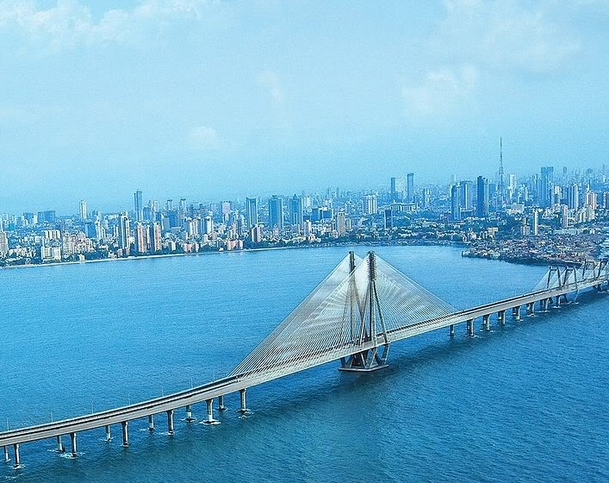
Problem statement
Design and implement the location analyser system which aims for less searching time for the stakeholders for the best locations for start-ups like opening a restaurant in a city Mumbai.
Mumbai view

Slide 5
Analysis of existing system
Until now there is no proper recommendation systems which recommends the best location for the start-ups. All the stakeholders are needed to search all over the city and take several others opinions to start a restaurant at some locations, sometimes it may be a better location and restaurant will be in profits and sometimes it may not. So our aim is to implement a better location analysis and recommendation system.

Slide 6
Requirements
Python idle (2.7 or more)
anaconda for jupyter notebook (version 1.7.2 or above)
Packages and Libraries
Numpy
Pandas
Matplotlib
Seaborn
Sklearn
Geopy
Geocoder
Folium

Slide 7
Data Collection
The following data was collected for this project:
neighbourhood data of Mumbai from https://en.wikipedia.org/wiki/List_of_ neighbourhoods_in_Mumbai
Geographical coordinates of Mumbai and all neighbourhoods in Mumbai using GeoPy and Geocoder libraries in python
Venue data for all neighbourhoods in Mumbai using Foursquare API

Slide 8
Neighbourhood Data
The data of the neighbourhoods in Mumbai was scraped from https://en.wikipedia.org/wiki/List_of_neighbourhoods_in_Mumbai
The data is read into a pandas data frame using the read_html() method. The main reason for doing so is that the Wikipedia page provides a comprehensive and detailed table of the data which can easily be scraped using the read_html() method of pandas. The top 10 rows of the data frame are shown in Figure 1.

Slide 9
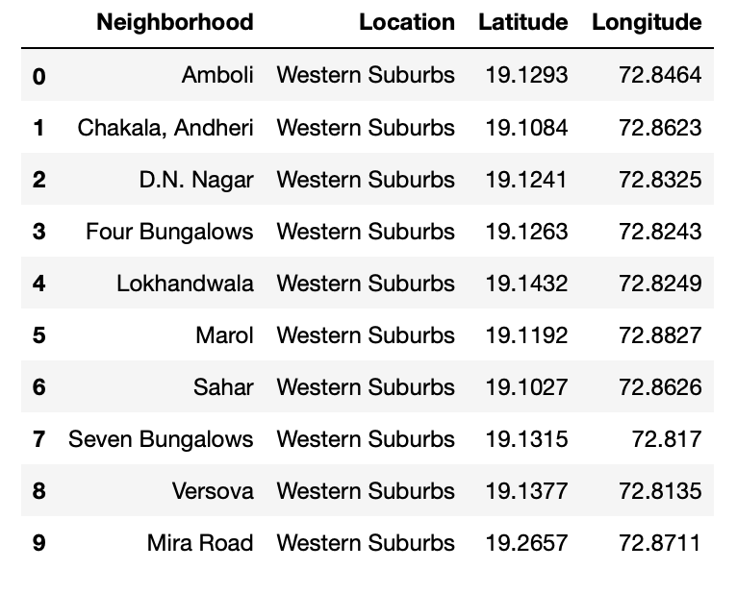
Dataset for Mumbai neighbourhoods
First 10 rows of Mumbai neighbourhood Data frame

Slide 10
Geographical Coordinates
The geocoder library in python has been used to obtain latitude and longitude data for various neighbourhoods in Mumbai. The coordinates of all neighbourhoods in Mumbai are used to check the accuracy of coordinates given on Wikipedia and replace them in our data frame if the absolute difference is more than 0.001. These refined coordinates are then further used for plotting neighbourhoods using the Folium library in python. Figure 3 shows the coordinates of neighbourhoods in Mumbai obtained from Wikipedia as ‘Latitude’ and ‘Longitude’ and those obtained from geocoder as ‘Latitude1’ and ‘Longitude1’. Furthermore, it also shows the absolute difference between the two latitude columns and the two longitude columns as ‘Latdiff’ and ‘Longdiff’, respectively. Once again only the top 10 rows are shown.

Slide 11
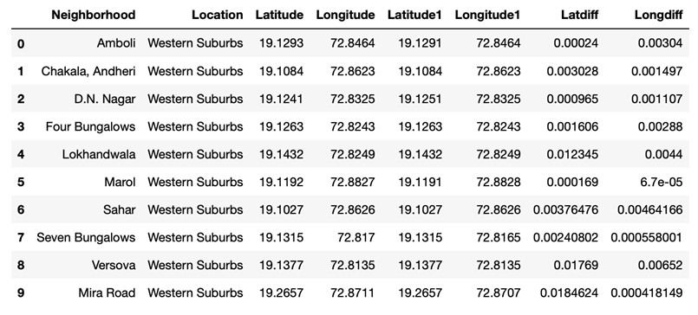
Absolute difference between latitude and longitude values obtained from Wikipedia and Geocoder.

Slide 12
Top 10 rows of the final Mumbai neighbourhoods data frame after replacing the latitude and longitude values as mentioned before and dropping unnecessary columns.

Slide 13
Venue data
The venue data has been extracted using the Foursquare API. This data contains venue recommendations for all neighbourhoods in Mumbai and is used to study the popular venues of different neighbourhoods as well as build the unsupervised learning model to cluster neighbourhoods. The venue recommendations of all neighbourhoods were obtained with a limit of 200, that is, maximum of 200 venue recommendations per neighbourhood and a radius of 1 km around the neighbourhood’s geographical coordinates. Figure 5 shows the top 10 rows depicting the results obtained after cleaning the data from Foursquare API.

Slide 14
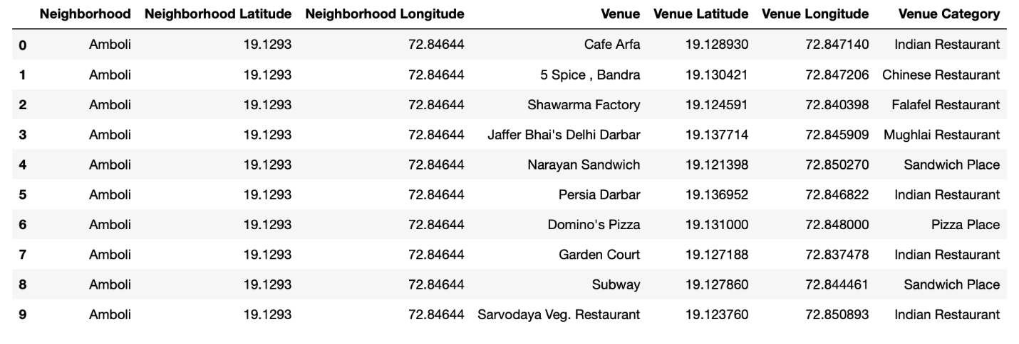
Venue dataset

Slide 15
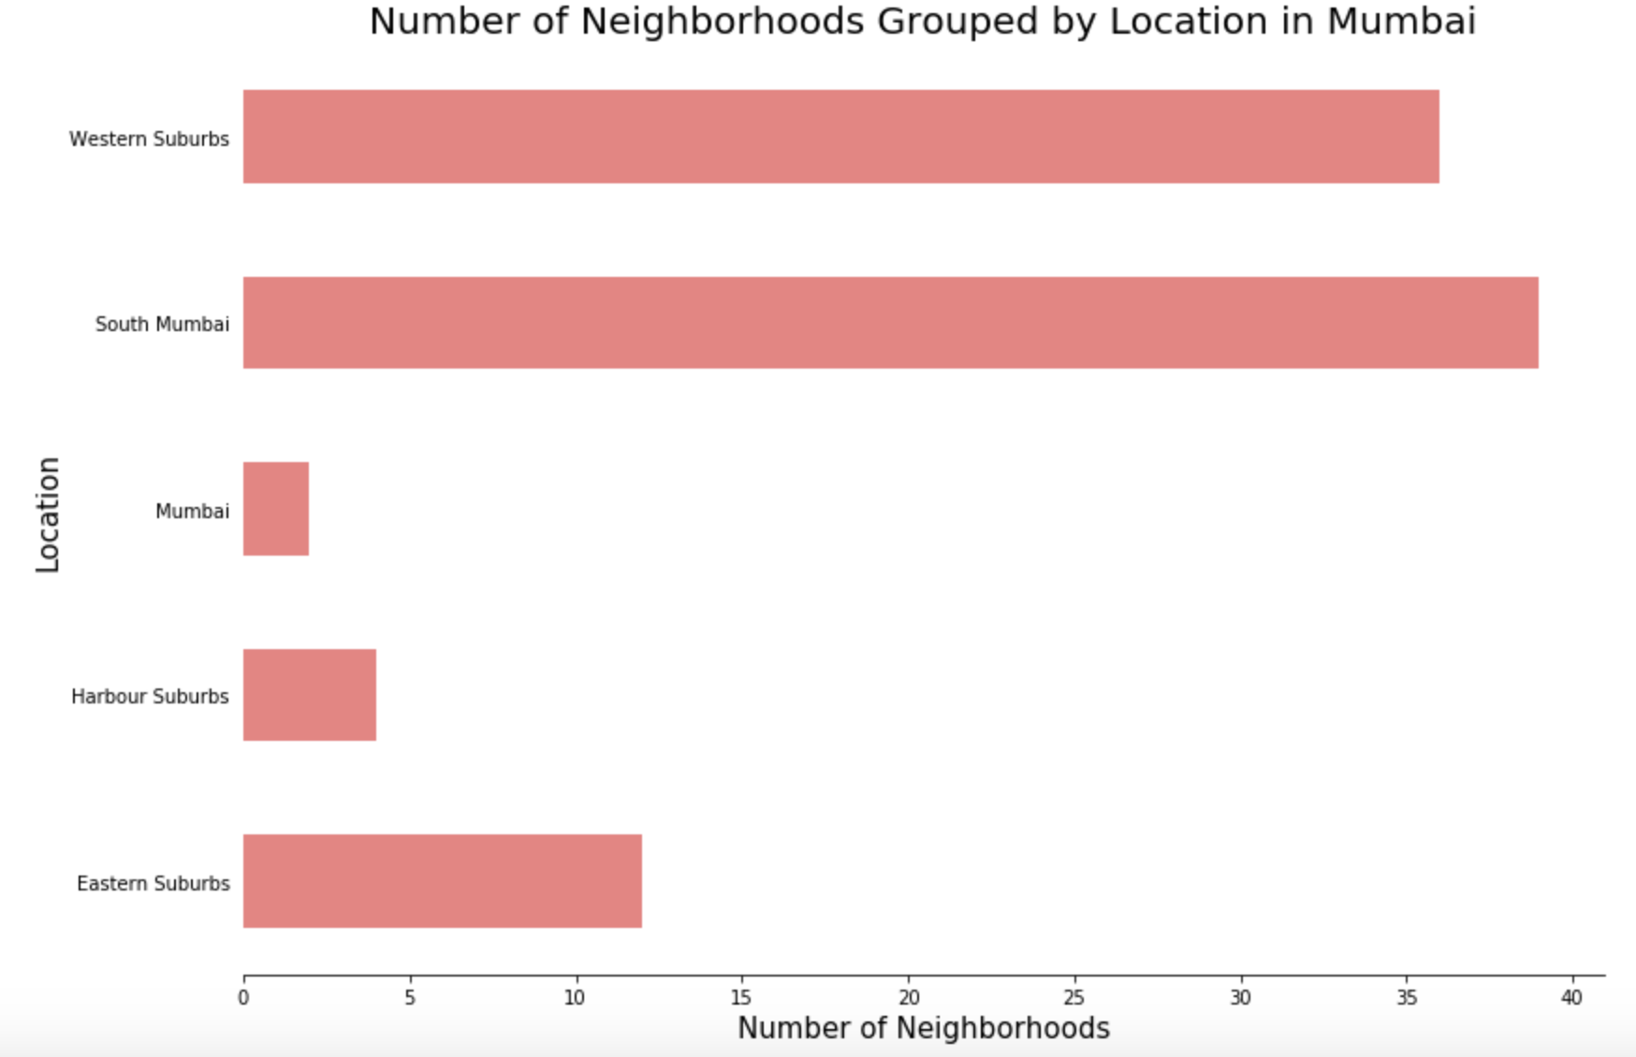
Methodology
Data Visualization
Mumbai neighbourhoods data was plotted for providing a better understanding
The graph alongside depicts the number of neighbourhoods in each location of Mumbai
All neighbourhoods on the outskirts of the city have been grouped as “Mumbai”
Western Suburbs and South Mumbai contain the highest number of neighbourhoods
Number of neighbourhoods grouped by location

Slide 16
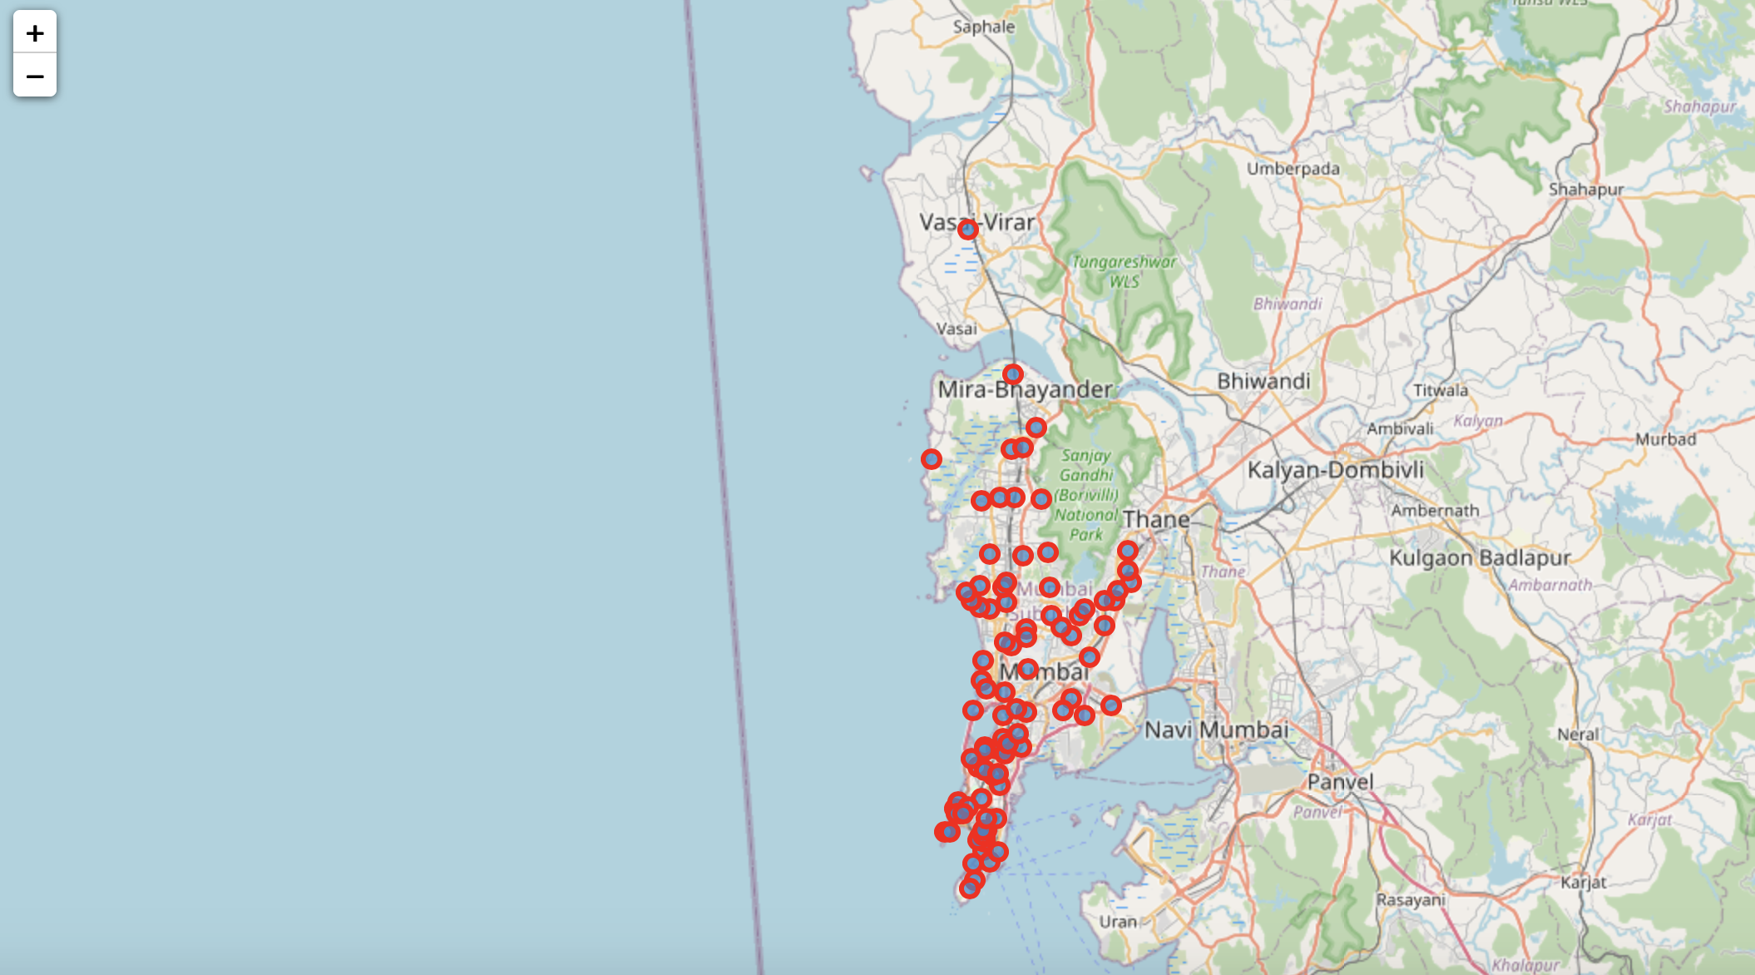
The Folium library in python was used to visualize the spread of all neighbourhoods across Mumbai
The neighbourhood spread across Mumbai

Slide 17
Feature extraction
One-hot Encoding
One-hot Encoding was used to encode venue categories to numeric values with 1 if a venue belongs to a category and 0 if a venue does not belong to a category for all neighbourhoods
The average is then taken for all venue categories in a neighbourhood to produce the data frame shown in next slide.

Slide 18
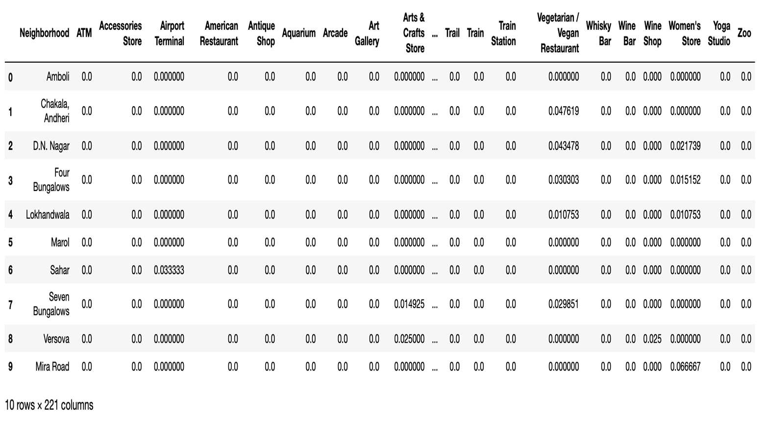
One-hot Encoding resulting data frame

Slide 19
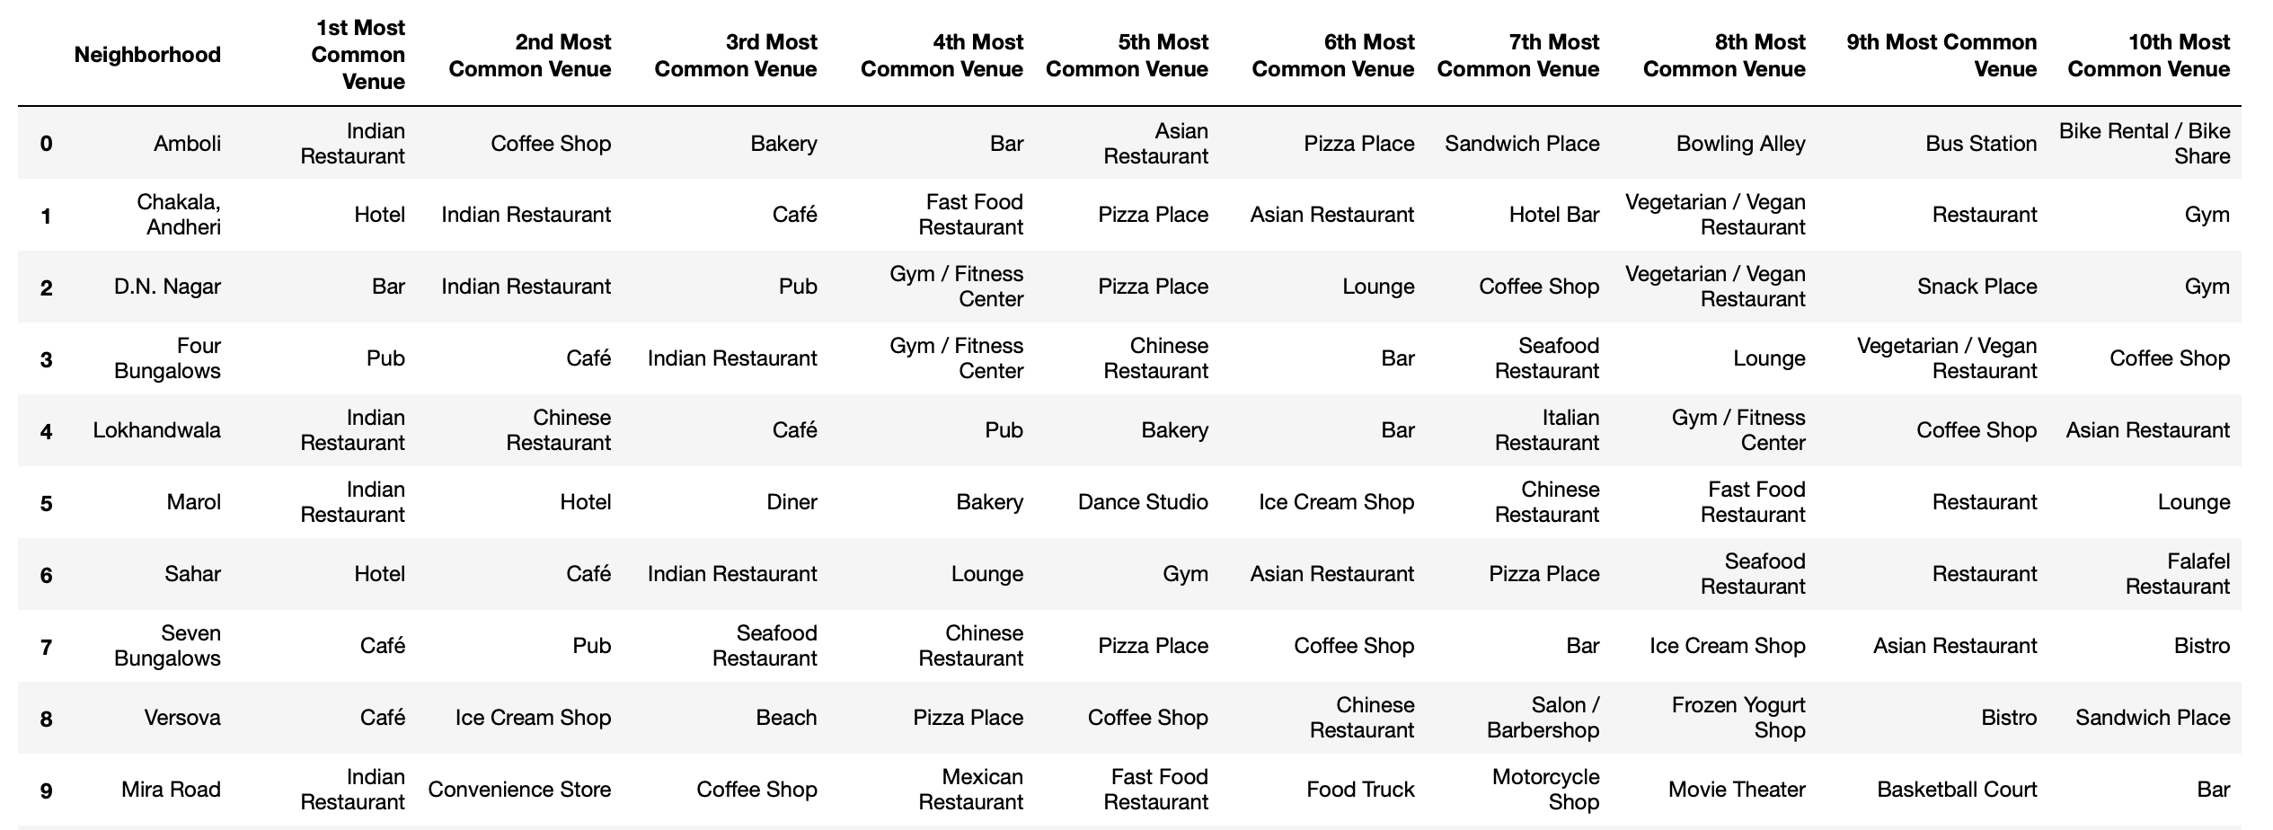
Dataset for Top 10 Most Common Venues
First 10 rows of top 10 most common venues for all neighbourhoods

Slide 20
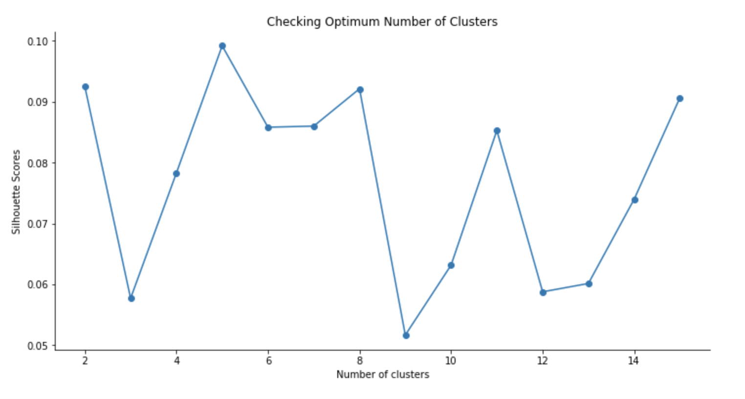
MACHINE LEARNING ALGORITHM
Unsupervised Learning Model
KMeans clustering was used to cluster neighbourhoods in Mumbai based on venue categories
The plot shows a maximum Silhouette Score for 5 clusters and thus the n_clusters parameter in KMeans clustering was set to 5
Silhouette scores for varying number of clusters in KMeans clustering

Slide 21
Results
Each neighbourhood received a cluster label based on clustering by the KMeans algorithm
The Cluster Label column along with the Location, Latitude, and Longitude columns were added to the top 10 most common venues data frame to provide the final results
This data frame is shown on the next slide

Slide 22
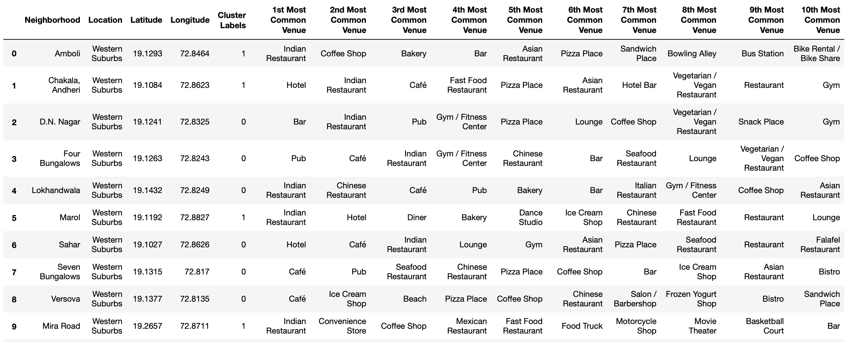
First 10 rows of clustering neighbourhoods in Mumbai data frame

Slide 23
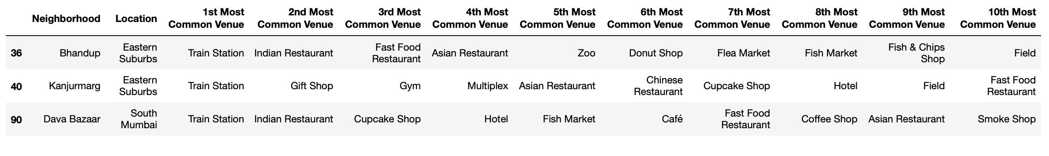
Cluster 1 and 2
Cluster 1
Cluster 2

Slide 24
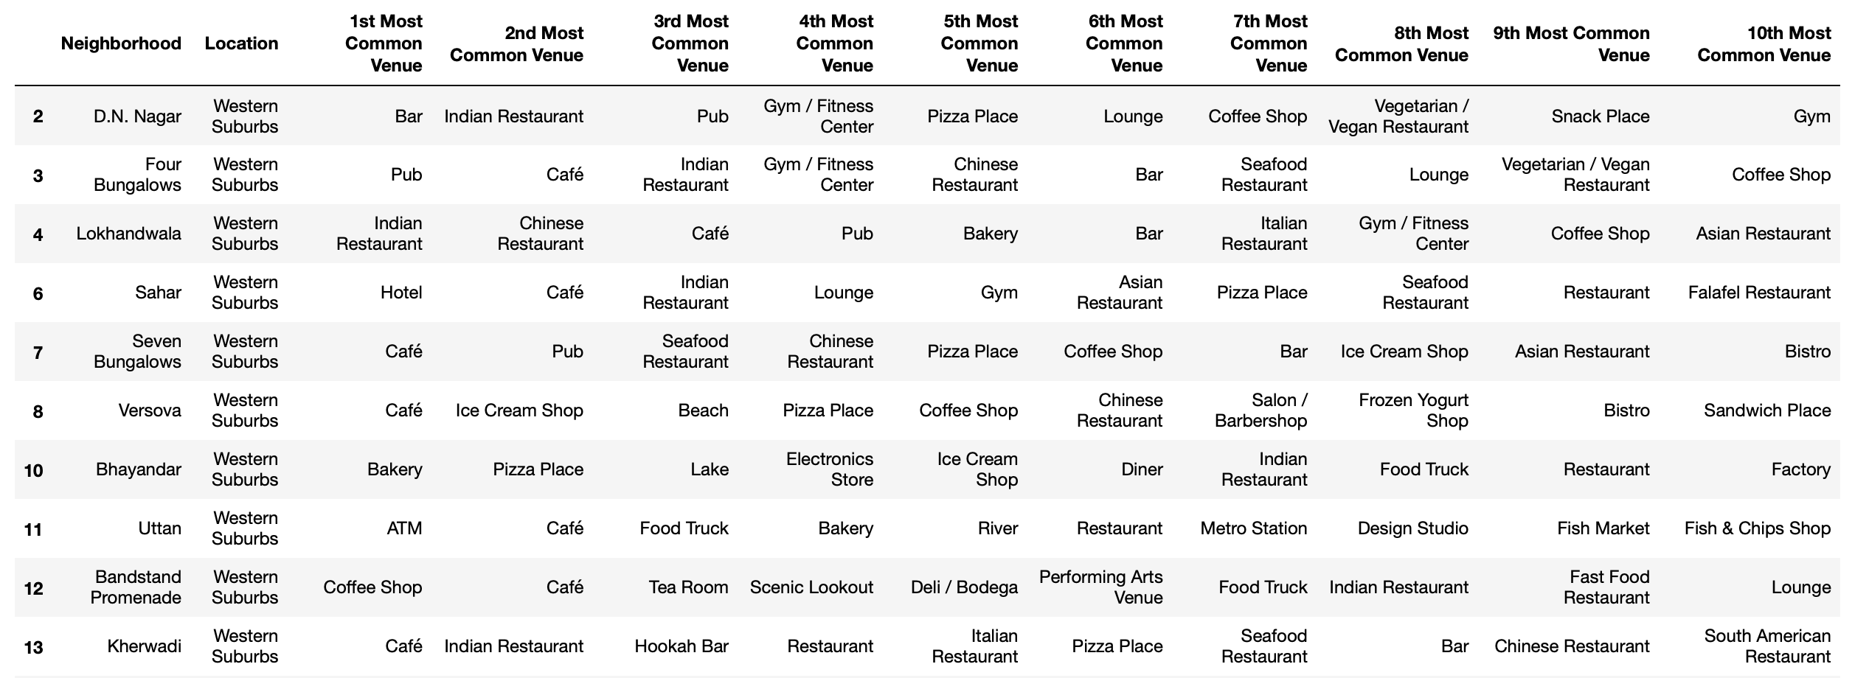
Cluster 3

Slide 25
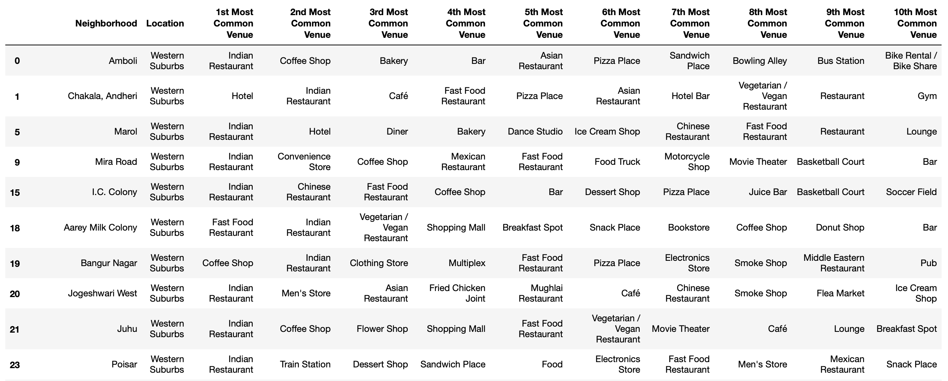
Cluster 4

Slide 26
Cluster 5

Slide 27
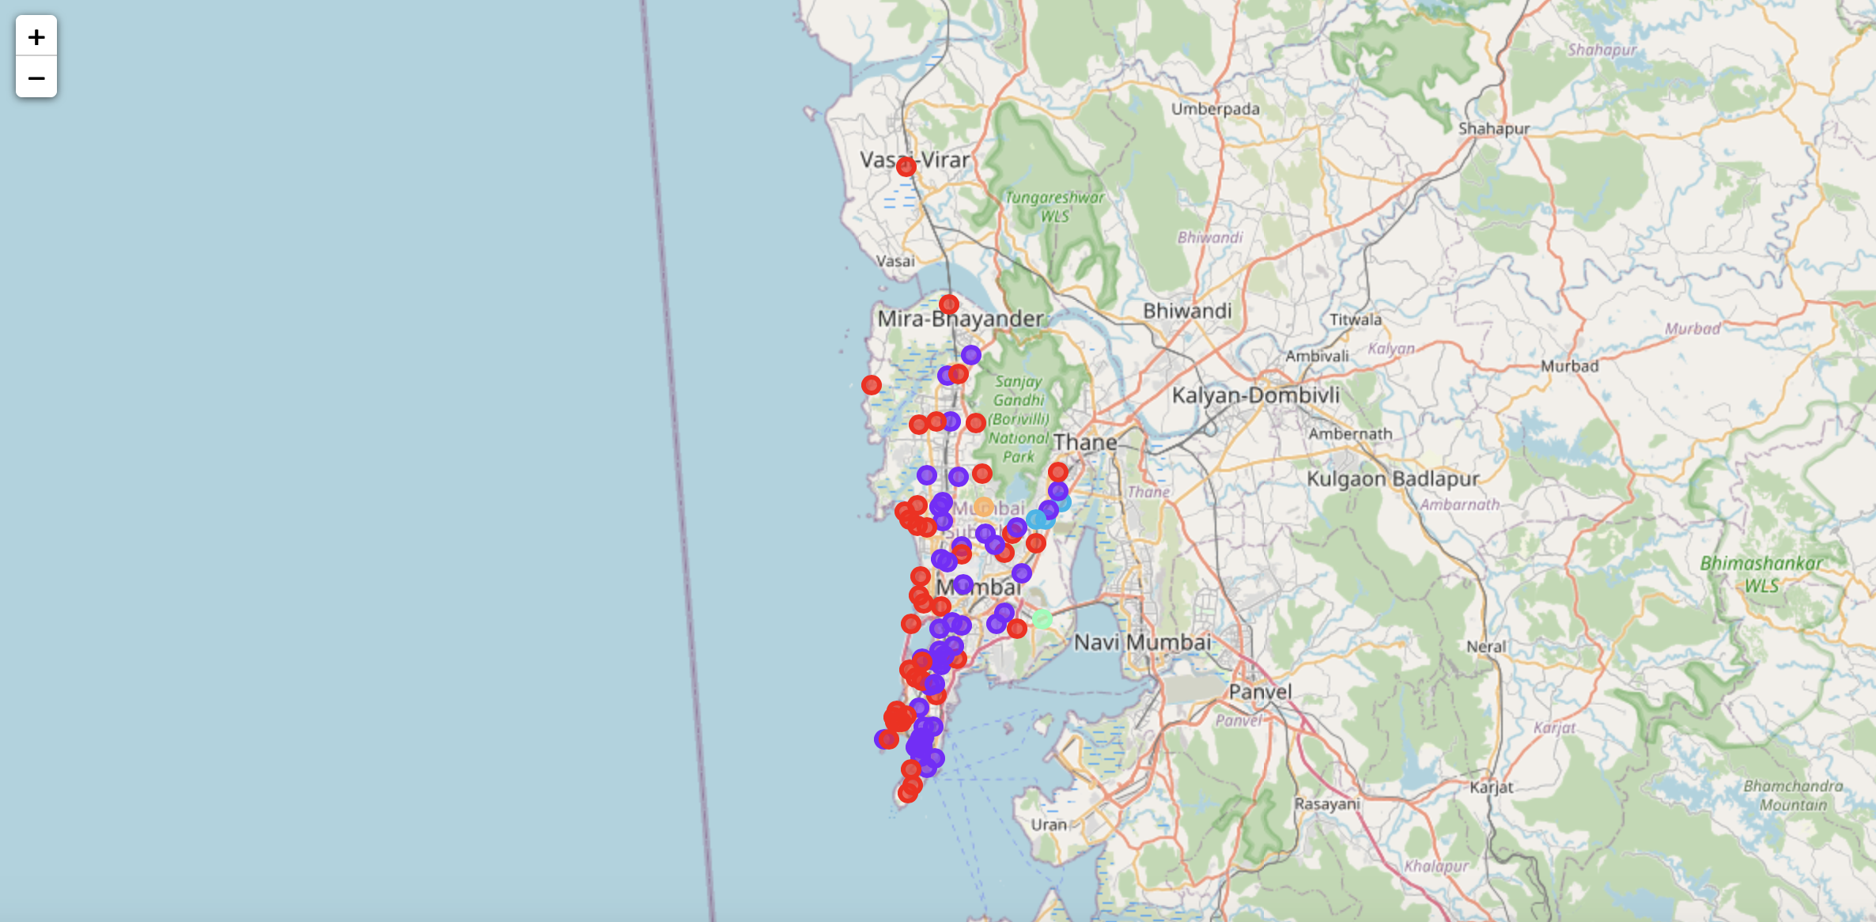
Visualization of neighbourhoods clusters was done using Folium in python
Different clusters correspond to different colors
Visualizing the clustering of neighbourhoods in Mumbai

Slide 28
Discussion
By analyzing the clusters, it is evident that neighbourhoods in cluster 1, 2, and 5 are not well suited for a new restaurant since they contain a high degree of other venues like train station, bus station, fish market, gym and smoke shop
Comparing clusters 3 and 4, we find that neighbourhoods in cluster 3 contain a much higher degree of food joints
neighbourhoods in cluster 4 contain many other venues like soccer field, flea market, smoke shop, gym, train station, dance studio and music store
Thus, the most optimal neighbourhoods for starting a restaurant are in cluster 3

Slide 29
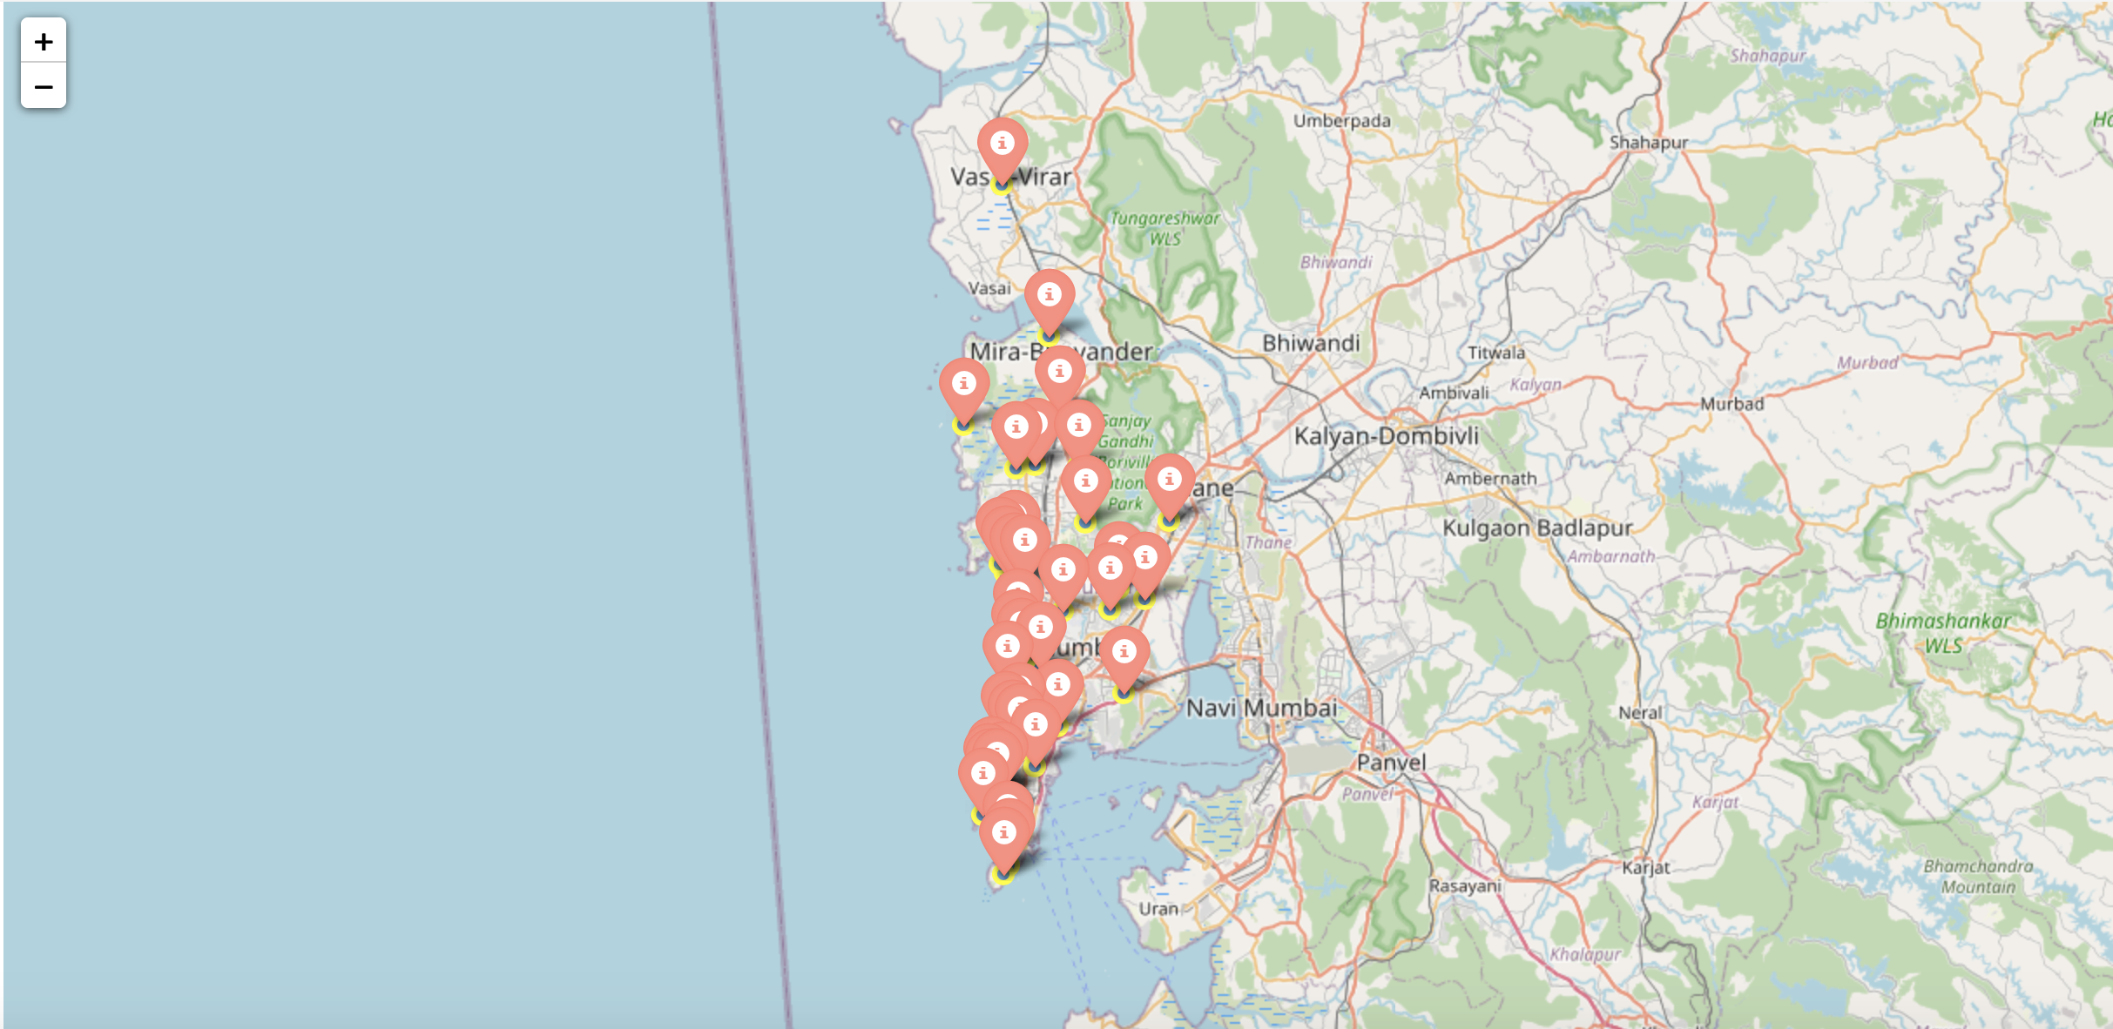
Plotting final results using Folium library in python
neighbourhoods in Mumbai that are most suited for starting a new restaurant (Cluster 3)

Slide 30
Conclusion
In this project, the neighbourhoods in Mumbai, India have been successfully analysed for determining which would be the best neighbourhoods for opening a new restaurant
Based on the analysis carried out, neighbourhoods in cluster 3 are recommended as locations for the new restaurant.
In this way we can analyse the location and prefer the best recommendations to the stakeholders.

Slide 31
Future work or scope
Now we built a location analyzer system for recommending best location to open a restaurant in Mumbai city. In future we can implement for any cities or any countries, and for not only restaurants we can implement it to build a playground or for an airport , for every aspect of location analyzing we can use our location analyzer system.
Some applications are:
Instead of working in just cities we can use a country’s map to find a better city for factory installation by analysing the resources available.
Shifting offices to better locality (or) something related to transporting goods from one city to another.

Slide 32
References
https://en.wikipedia.org/wiki/List_of_neighbourhoods_in_Mumbai
https://developer.foursquare.com/docs/developer-console
https://www.freecodecamp.org/news/8-clustering-algorithms-in-machine-learning-that-all-data-scientists-should-know/

Slide 33
THANK YOU

